Slide 1
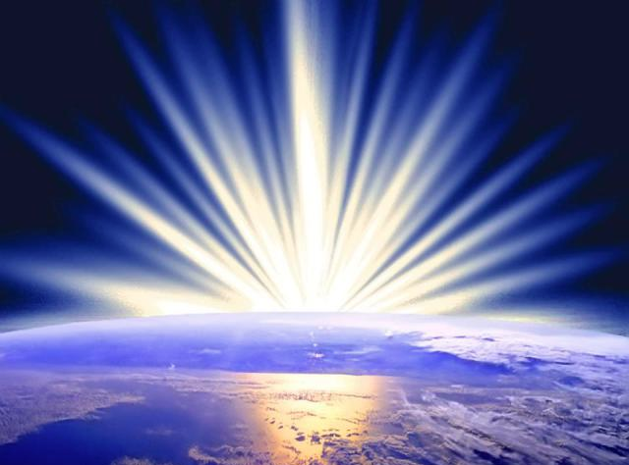
Mistreated Yet Missions-Focused
The Church of Philadelphia (Rev. 3:7-13)
Dr. Rick Griffith, Crossroads International Church Singapore cicfamily.com & BibleStudyDownloads.org

Slide 2
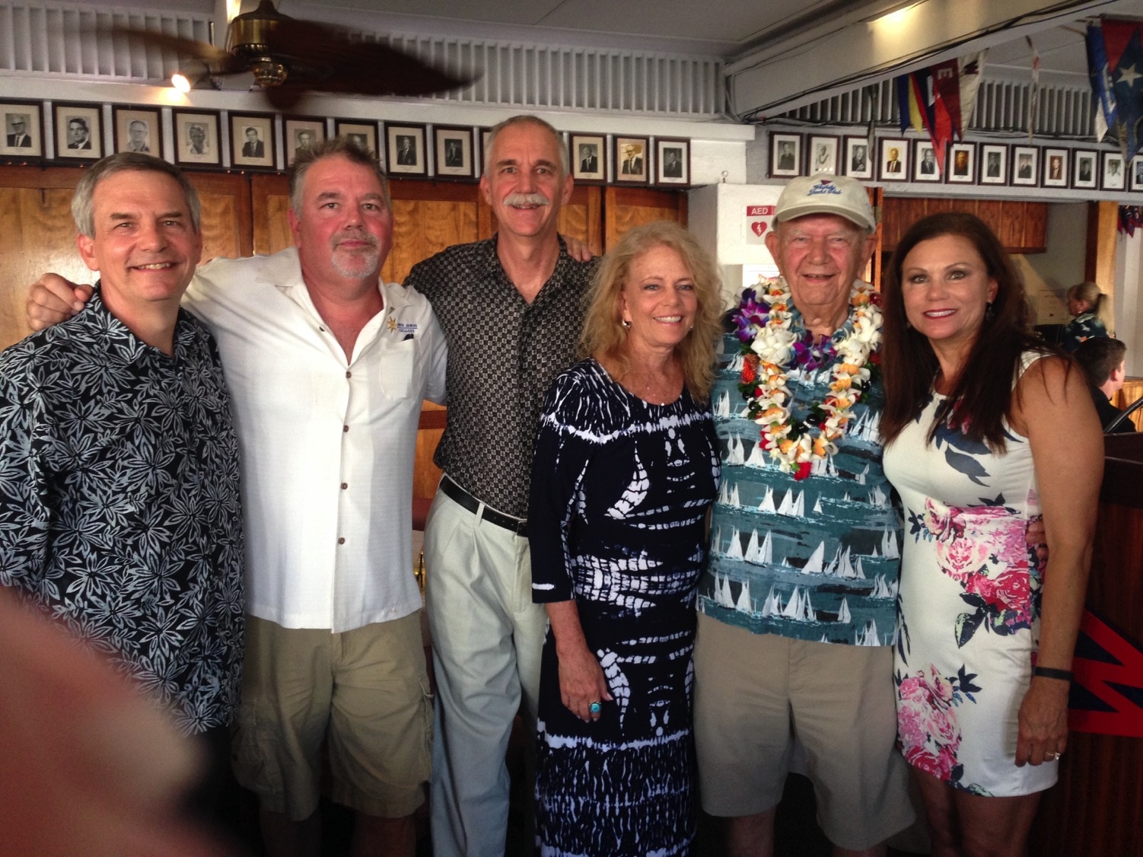
Hal Griffith, age 90

Slide 3
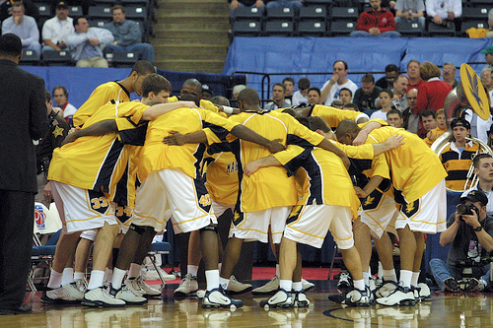
The Huddle
Notes:
One of the nicest parts of several different sports is the huddle. The team gets together in a circle to plan their strategy for the game and senses a spirit of unity and camaraderie.

Slide 4
Who hates unity?
No one.
Notes:
After all, who hates unity? No one.

Slide 5
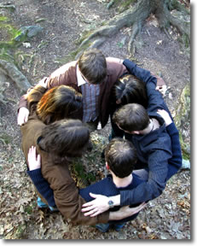
Our Huddle
Thank God for making us one despite our many countries!
Notes:
We certainly don’t at our church. We work hard to be a united family, despite our 16 countries represented. What a joy to come together and worship the same Jesus, who stemmed from none of our nationalities here!

Slide 6
The Huddle
Notes:
But huddles have an inherent danger. Huddles are designed to be temporary until the team goes back into the game. But what if the team never left the huddle?

Slide 7
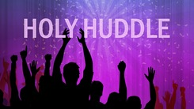
The Holy Huddle
THE HOLY HUDDLE
Worship • Unity • Focus
Notes:
When this applies to churches it is has been sometimes called “Holy Huddle.” There is worship of the true God, unity of purpose and focus on holiness.

Slide 8
The Holy Huddle
Where everyone looks • acts • sounds • smells just like us!
Notes:
But there is also the danger of liking to be around people who look like us, act like us, sound like us, smell like us. That’s not unity—its uniformity!

Slide 9
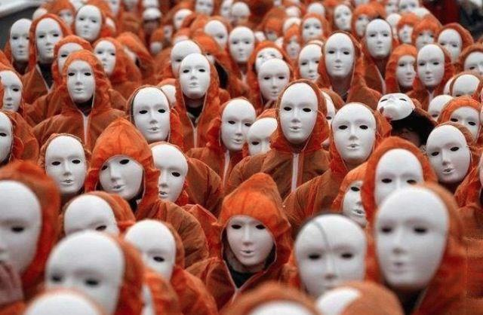
The Holy Huddle
Uniformity—not unity
Notes:
That is dangerous! To accomplish uniformity we must all wear masks.

Slide 10
Why do you like this church?
Notes:
Why do you like this church? At times I have heard people say they like being in a small church. Small churches have their advantages, like being able to learn everyone’s name within a few weeks.

Slide 11
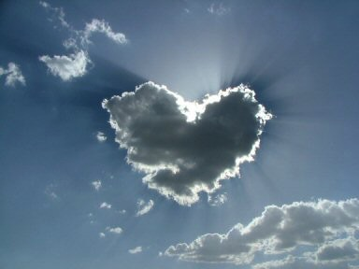
Our Vision is to…
Love God
Love the Church
Notes:
This is when we “love the church” too much, as in our vision statement.
11

Slide 12
Do you want us to stay small?
Where everyone looks like you
Notes:
But do you want this church to remain small?
Do you fear getting big where you’ll lose the family atmosphere?
Do you fight growth?
Or do you enfold new people?
Do you invite others to church?

Slide 13
What does Jesus want for us? Doesn't he want us to reach out?
How does Jesus encourage us to reach out?
Notes:
More important than what we want is what Christ wants for us. He certainly wants us to reach out, but how does Jesus encourage us to reach out?

Slide 14
Revelation
The Seven Churches of Revelation
The Writing Ministry of Jesus
How does Jesus encourage us to reach out?
Notes:
Today we jump into the study of a small group of seven churches in the Roman province of Asia—

Slide 15
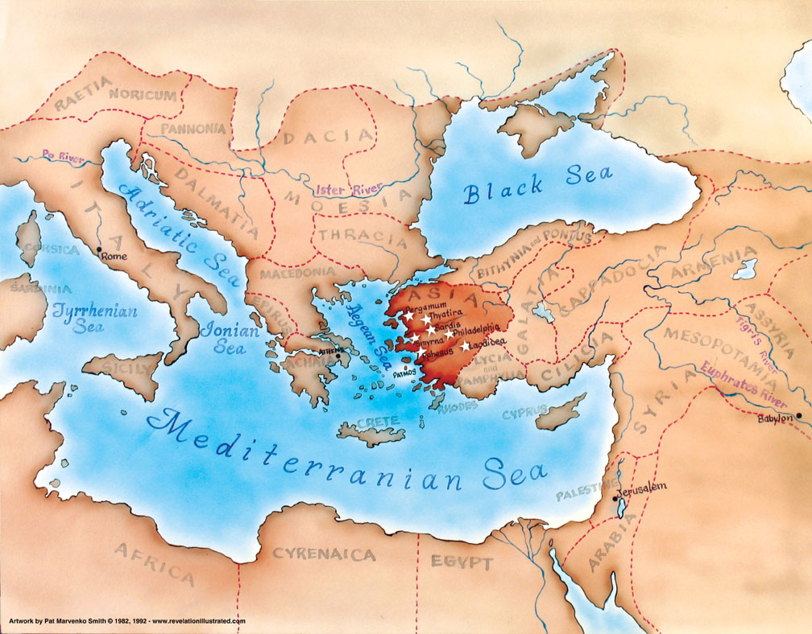
Asia in the Roman Empire
321
Notes:
—and we’ve found that they aren’t too different from our churches in modern Asia or Hawaii!

Slide 16
What did John see around him?
Title Page 321
Asian Churches
Rome
2. External Persecution from Rome (1:9; 2:9-10; 3:10)
1. Internal Struggles inside churches (2:4, 14-15, 21-24; 3:1, 15-17)
Notes:
All had internal problems and also were opposed by Rome at the end of the first century.

Slide 17
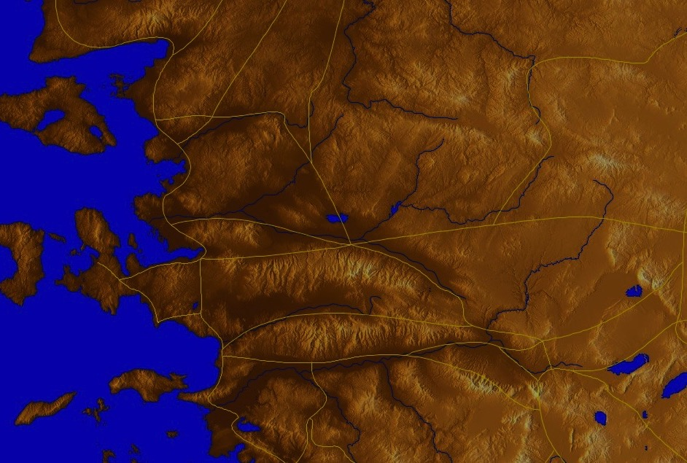
The Chiasm (Rev. 2–3)
366
Ephesus
Existence Threatened
Smyrna
Faithful in Persecution
Pergamum
Mixed Bag
Thyatira
Sardis
Philadelphia
Laodicea
Notes:
Up to where we start today, five letters to these churches were revealed, and many were not faithful. The letters actually form a chiasm, or literary structure where previous elements are repeated in reverse order.
• For example, the continued existence of the first church at Ephesus was threatened—but the same is said of the last church at Laodicea.
• The second church, Smyrna, in contrast, was faithful in persecution—and the same is said of the second-to-last church of Philadelphia.
• The three middle churches were a mixed bag.
All of these churches were suffering some level of persecution—and difficulty has its natural way of making us hunker down rather than reach out.

Slide 18
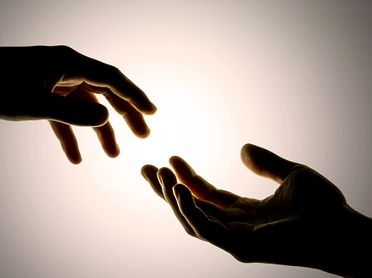
So how does Jesus encourage us to reach out?
In two ways…
Rev. 3:7-13
Notes:
But today we will see two ways that Jesus encourages us to reach out.
Revelation 3:7-13 shows us how Jesus encourages the church at Philadelphia—and us—to reach out.
(The first way that Jesus encourages us to reach out is that...)

Slide 19
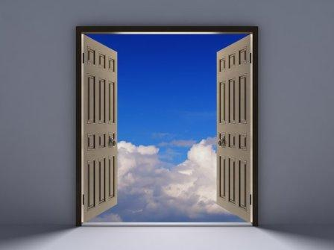
1. Christ opens doors for witness (3:7-8).
Notes:
We often fear evangelism, but it is none other than Jesus himself who brings us evangelistic occasions!

Slide 20
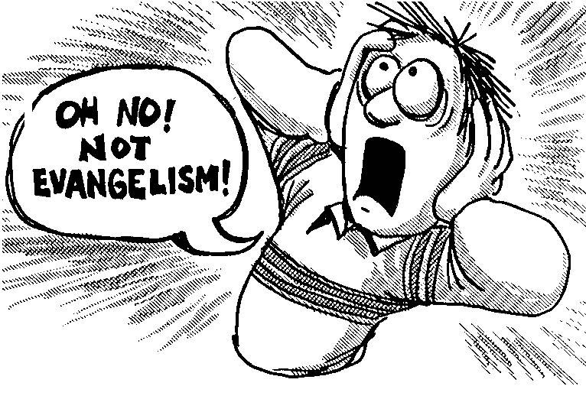
OH NO! NOT EVANGELISM!
Notes:
We often fear evangelism, but it is none other than Jesus himself who brings us evangelistic occasions!

Slide 21
Christ gave Philadelphia opportunities to witness (3:7-8).

Slide 22
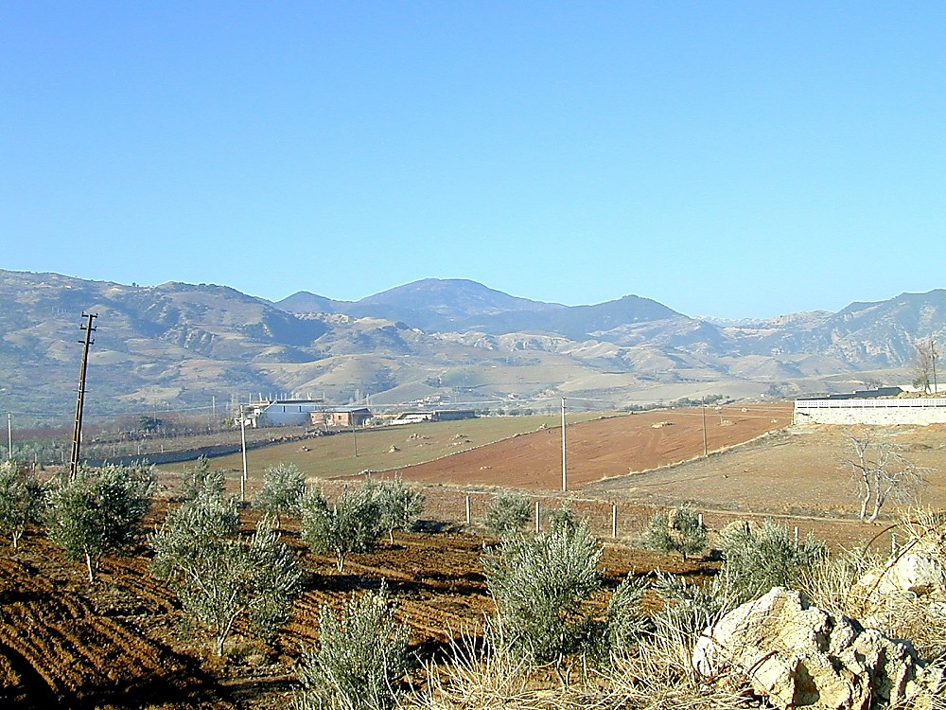
Philadelphia view to south from acropolis
Founded by Eumenes II, king of Pergamum, or his brother, Attalus II Philadelphus (reigned 159-138 BC), meaning "lover of his brother"
Philadelphia view to south from acropolis
Notes:
Historical Background (BiblePlaces.com)
Philadelphia was founded either by Eumenes II, king of Pergamum, or his younger brother Attalus II, who reigned from 159-138 B.C. Founded in honor of Attalus II, the name of the city means "lover of his brother." This refers to Attalus' loyalty to his brother in refusing to overthrow him, even amidst encouragement from advisors to do so.
___________
At the edge of the Katakekaumene (the "burned land") was a fertile volcanic plain suitable for agriculture, especially grapes; Philadelphia came to be known for its grape production. It was located in a region plagued by many earthquakes, which severely damaged the city in 17 and 23 A.D. Out of gratitude to Emperor Tiberius for his help in rebuilding it, the city took on the name Neo Caesarea. Emperor Rasmanianus changed this name to Plabia, after his wife, but this name also quickly went out of use.

Slide 23
Where was Philadelphia?
345
Adramyttium
Aezani
Pergamum
Thyatira
Cyme
"Gateway to the East"
Erythrae
Sardis
Smyrna
Eumenia
Philadelphia
Lebedus
Colophon
Ephesus
Nysa
Laodicea
Hierapolis
Trailes
Heraclea
Aphrodisias
Colossae
Alabanda
Patmos
Miletus
Notes:
"…Philadelphia was located on the junction of several important trade routes, earning it the nickname "gateway to the east." The city was intended to serve as a base for the spread of Hellenism [Greek culture] to the recently-annexed territories of Lydia and Phrygia…" (Bolen slide 6, point 2)
(BiblePlaces.com)

Slide 24
Philadelphia (Rev. 3:7-13)
359
Pergamum
Thyatira
Christ:
Holy and true, holds the key of David
Smyrna
Sardis
Ephesus
Philadelphia
Laodicea
Notes:
The letter begins with a…
Description of Christ: He is holy, true and able to give opportunities for service (3:7b-c).

Slide 25
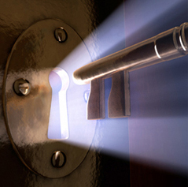
"This is the message from the one who is holy and true, the one who has the key of David" (3:7b NLT)
Notes:
"Holy" means Christ is worthy to judge the spiritual life of the Philadelphia church.

Slide 26
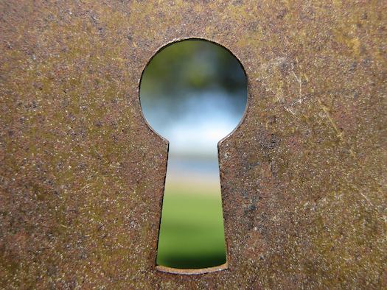
"I will give [Eliakim] the key to the house of David—the highest position in the royal court. When he opens doors, no one will be able to close them; when he closes doors, no one will be able to open them" (Isa. 22:22 NLT)
"key" = access to David's wealth
= holding spiritual treasures (e.g., opportunities for service)
Notes:
This quotes Isaiah 22:22, where David’s court officer, Eliakim, had access to all of King David’s wealth. Likewise, Christ holds all spiritual treasures, including opportunities for service!

Slide 27
"What he opens, no one can close; and what he closes, no one can open" (3:7c NLT)

Slide 28
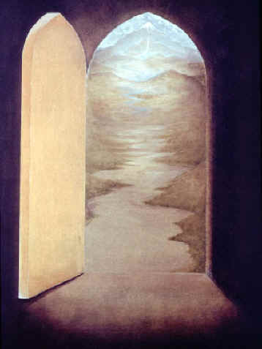
"I know all the things you do, and I have opened a door for you that no one can close. You have little strength, yet you obeyed my word and did not deny me" (3:8 NLT).
Commendation: He gave them opportunities based on their faithfulness (3:8).

Slide 29
Philadelphia (Rev. 3:7-13)
359
Pergamum
Thyatira
Commendation:
Deeds, keeps Christ's word and does not deny His name, endures patiently
Christ:
Holy and true, holds the key of David
Smyrna
Sardis
Ephesus
Philadelphia
Laodicea
Notes:
They were faithful, obedient, didn’t deny Christ, and endured.

Slide 30
Jesus has given this church many open doors for witness too!
"…I have given you an open door that no one can shut…" (3:8 NLT)
Notes:
So Christ gave them an open door for ministry—and you know what? Christian testimony continues in this city even to today!

Slide 31
Crossroads People Jan 2016
FRANCE
GERMANY
ITALY
NETHERLANDS
JAPAN
LEBANON
KOREA
HONG KONG/CANADA
TAIWAN
CHINA
MYANMAR
INDIA
USA
MALAYSIA
PHILIPPINES
ZIMBABWE
SINGAPORE
CIC
NEW ZEALAND
INDONESIA
Notes:
Jesus has given our church many open doors for witness too.
_____________
Our Jan 2016 church people stem from 14 different countries around the world.
Netherlands (Desiree), Valentin (France), Mark Lass (Germany), Cynthia, Pashauli (India), Kaori (Japan), Jieun (Korea), Mher & Liana (Lebanon), Ping (Malaysia), Raymond (Myanmar), Miriam (USA), Le Kim (Philippines), Singapore (Albina), New Zealand (Matt & Julie), Hong Kong/Canada (Larry Pun)

Slide 32
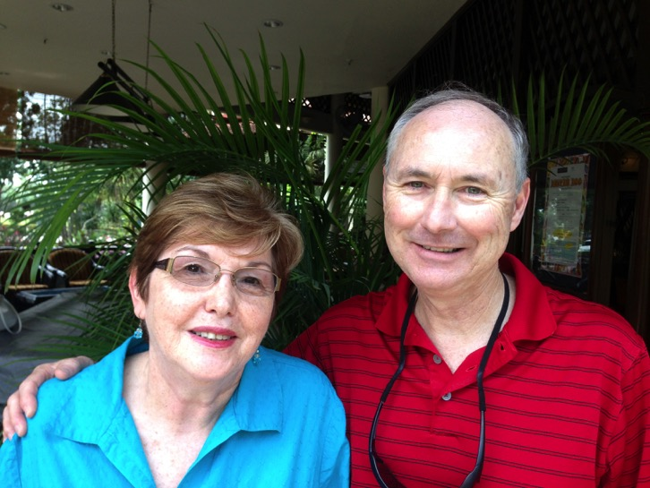
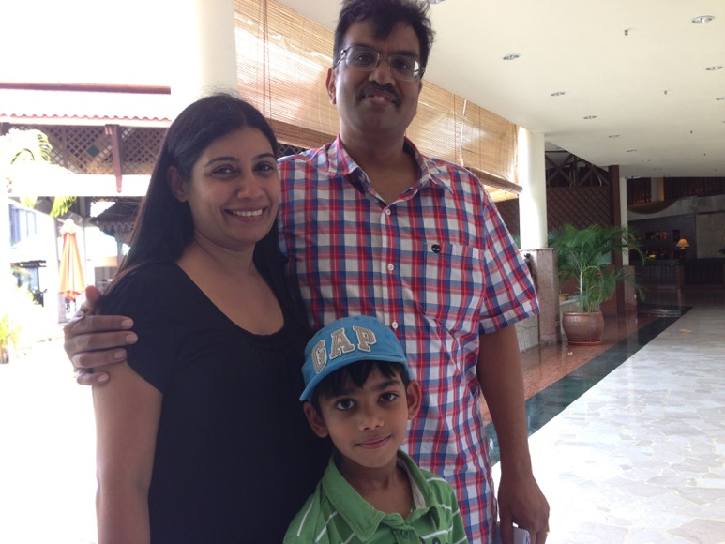
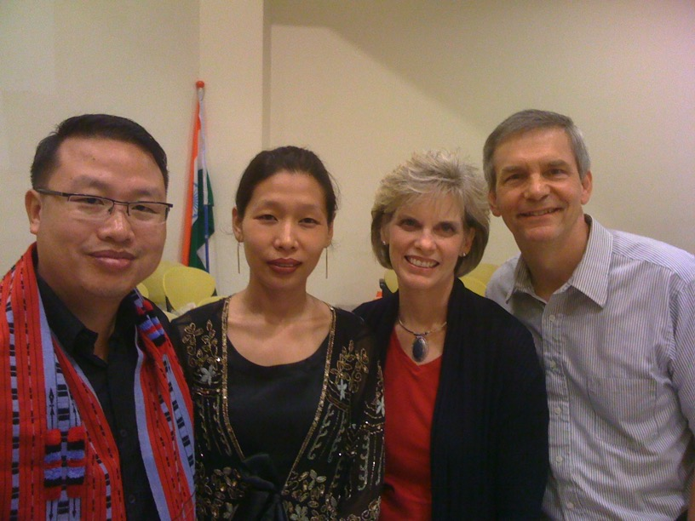
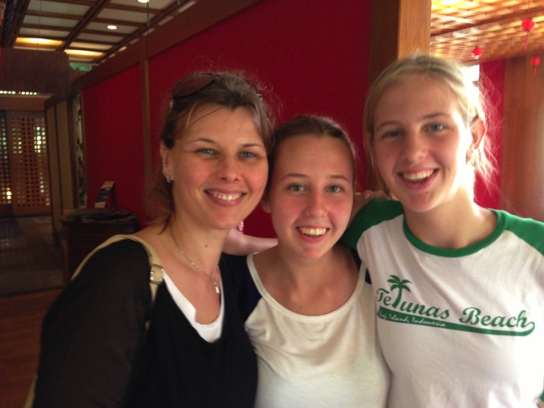
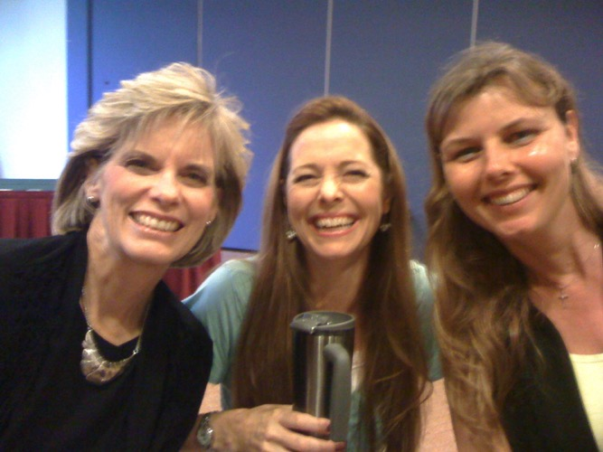
Let's reach out to more of our own people living in “our own backyard”!
Crossroads International Church
Notes:
We come from 14 nations, so we have doors to others in our nationalities right in Singapore.

Slide 33
Our Vision is to…
Love God
Love the Church
Love the Nations
Notes:
We have open doors to love the nations by supporting missions.
Our third part of our vision statement is to love the nations.
33

Slide 34
Our Mission Giving
• Thailand • Vietnam • India • Mongolia • Philippines • Myanmar
• Pakistan
• Bangladesh • Afghanistan • Nepal
Notes:
We give to about 11 countries now.

Slide 35
Missions Giving
20%
Notes:
We commit to give at least 20% of offerings overseas.

Slide 36
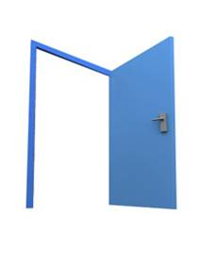
Open door to mission trips
"…I have given you an open door that no one can shut…" (3:8 NLT)
Notes:
In 2013 we gave 28% of offerings outside of Singapore

Slide 37
56 Teaching Trips (1997-2015)
MONGOLIA
JORDAN
KOREA
CHINA
NEPAL
MYANMAR
INDIA
THAILAND
VIETNAM
MALAYSIA
SRI LANKA
SINGAPORE
SBC
INDONESIA
Notes:
We have open doors in mission trips.
I have to do this to keep fresh, so I’ve had 56 trips to 12 nations the past 19 years that I’ve been training pastors in other nations outside Singapore

Slide 38
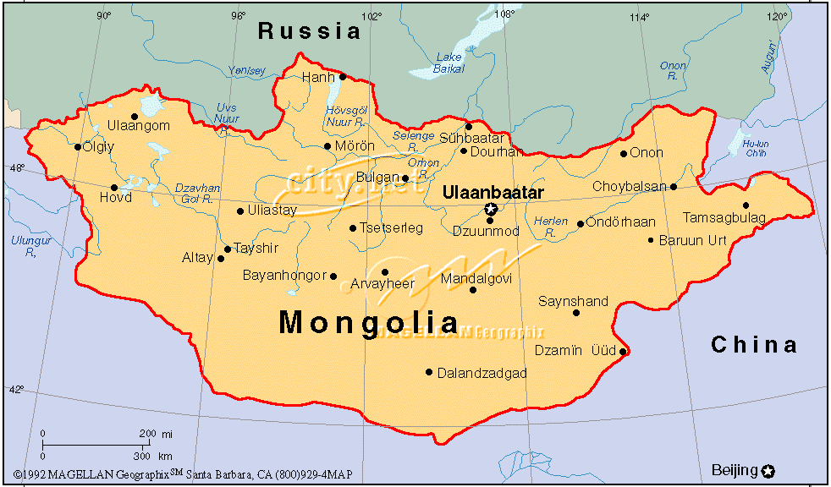
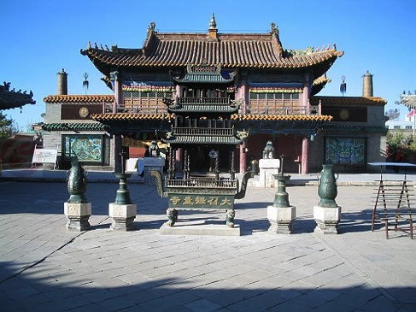
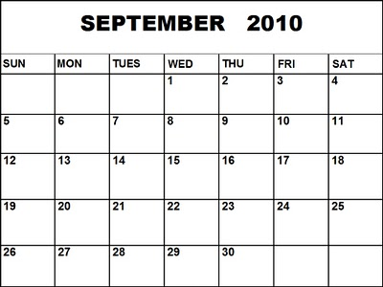
2010 MISSION TRIP
Where? MONGOLIA
When? September 4-12, 2010
What? Teaching
Notes:
CIC has sponsored members on mission trips to Mongolia

Slide 39
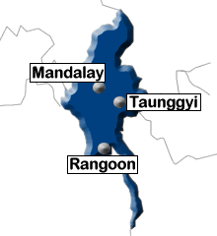
2012 MYANMAR MISSION
Who? Lewis & Barbara Winkler
Where? YANGON
When? 30 Nov-3 Dec
What? Officiating & Teaching
Notes:
and Myanmar in recent years—plus our youth in China, Philippines, Mexico, Ethiopia, and India.

Slide 40
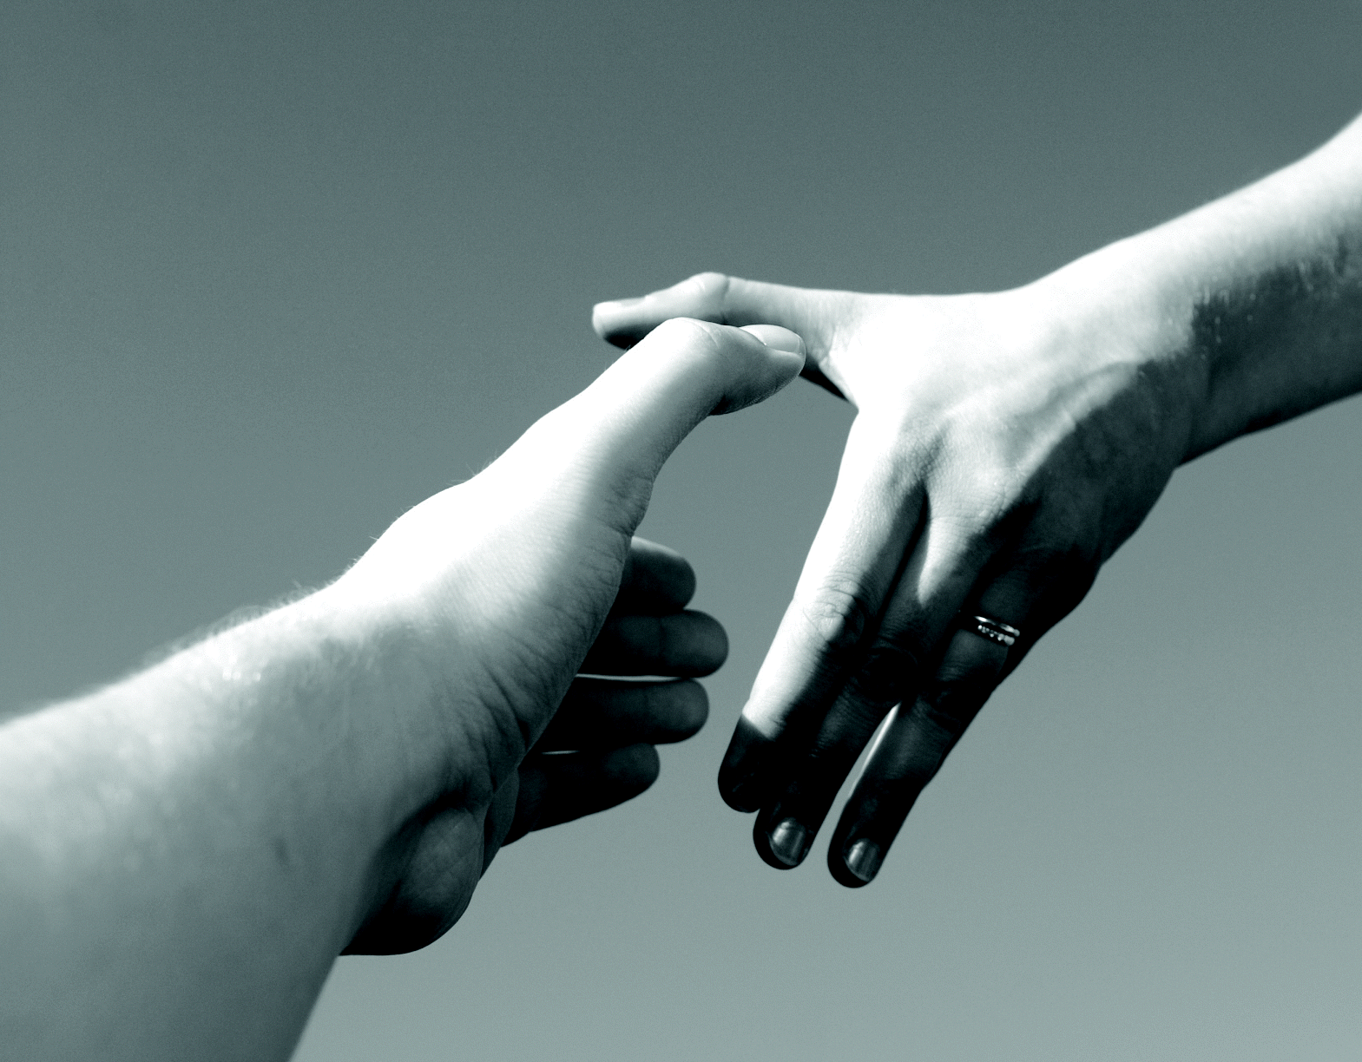
Invitations to Reach Outside Singapore in 2016
Myanmar: Jonathan Stone
Thailand: Manik Corea
Notes:
Our church has invitations to Bangkok and Yangon this year by CIC members living in Thailand and Myanmar.

Slide 41
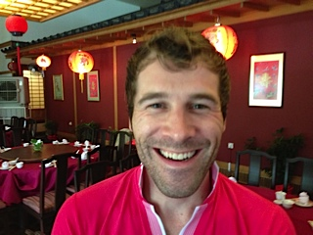
Myanmar 2016?
Jonathan Stone
Notes:
Jonathan Stone has asked for our help in Yangon.

Slide 42
The Coreas in Bangkok, Thailand since July 2008
Notes:
Manik Corea is planting an international church in Bangkok…

Slide 43
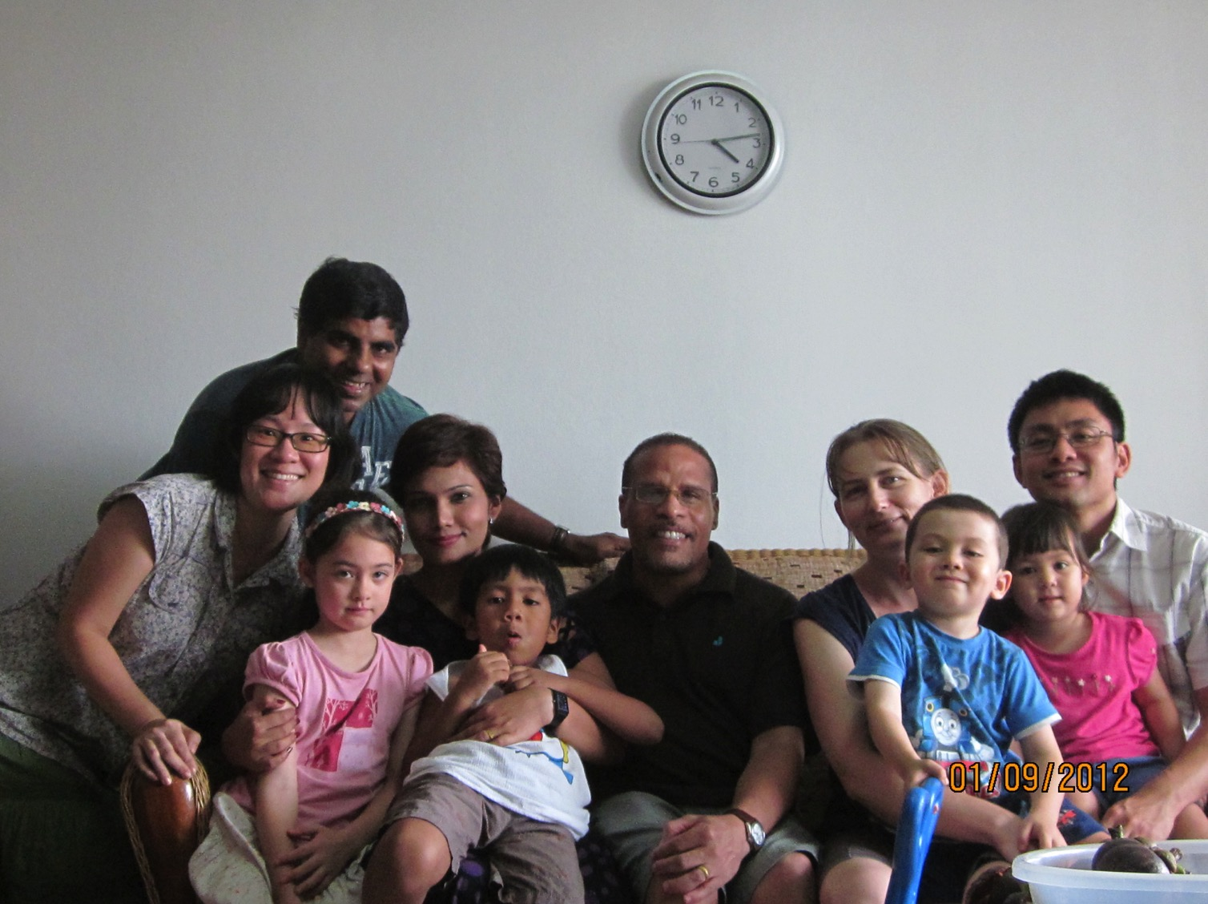
Manik's International Church Plant
Notes:
… and could use help.

Slide 44
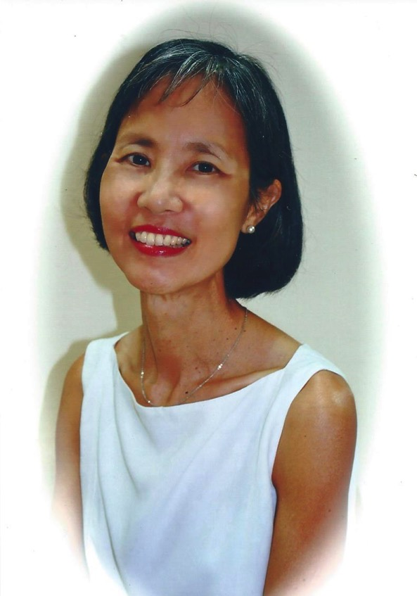
Lakeside Family Centre
Albina Chan
Notes:
We have open doors at Lakeside Family Services where Albina Chan serves to counsel youth, teach English, etc.

Slide 45
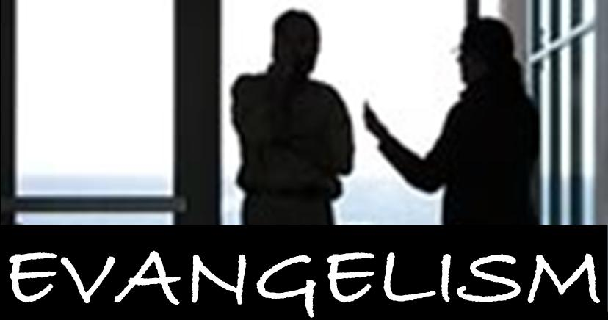
Prison
"I have given you an open door that no one can shut" (3:8)
EVANGELISM
Notes:
We have open doors in prison ministries

Slide 46
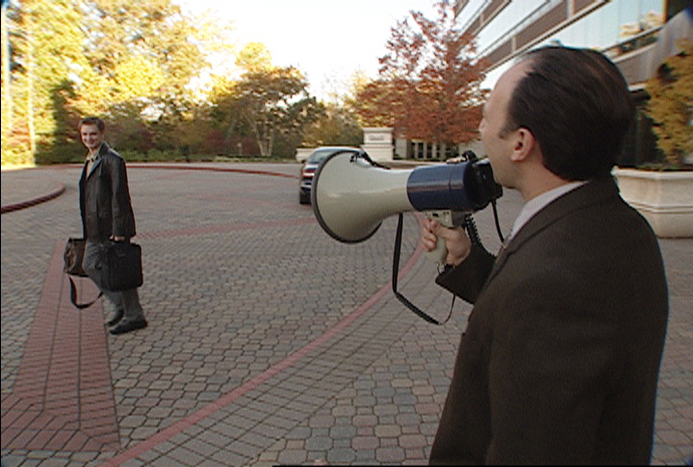
Ineffective Evangelism
Notes:
Too often we use ineffective means to share Christ.

Slide 47
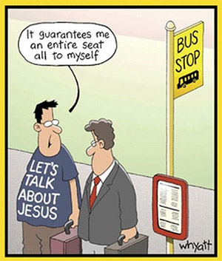
Let's be enfolding
Notes:
Sometimes believers aren’t too enfolding either in our evangelism.

Slide 48
Your place of work is a mission field too!
"I have given you an open door that no one can shut" (3:8)
Notes:
But we have open doors at our natural places such as our places of business.

Slide 49
Just talk to people!
"I have given you an open door that no one can shut" (3:8)
Notes:
Just talk to people and you will discover there are more open doors than you ever imagined!

Slide 50
So how does Jesus encourage us to reach out?
In two ways…
Rev. 3:7-13
Notes:
So Jesus encourages us to reach out in 2 ways.

Slide 51
1. Christ opens doors for witness (3:7-8).
Notes:
First, Christ opens doors for witness.
But what is the second way he encourages us to witness?

Slide 52
2. Christ promises rewards for service (3:9-13).
Notes:
Jesus will not forget to bless us for serving him!

Slide 53
Philadelphia (Rev. 3:7-13)
359
Promise
Christ promised Philadelphia believers benefits for their perseverance (3:9-13)
Warning
None
Pergamum
Thyatira
Exhortation
Hold on to what you have
Rebuke
None!
Commendation:
Deeds, keeps Christ's word and does not deny His name, endures patiently
Christ:
Holy and true, holds the key of David
Smyrna
Sardis
Ephesus
Philadelphia
Laodicea

Slide 54
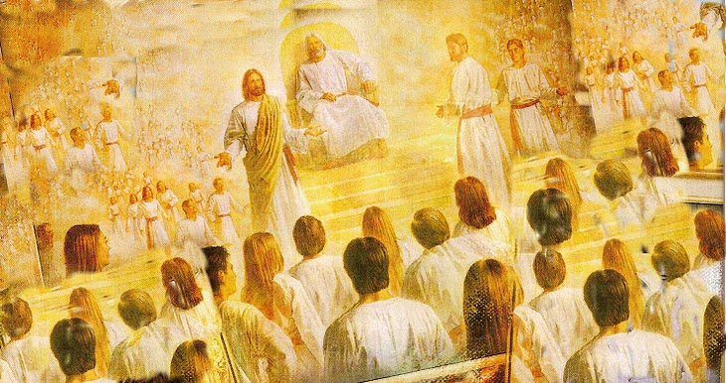
Christ promises honor before enemies (3:9).
"I have given you an open door that no one can shut" (3:8)
"Look, I will force those who belong to Satan's synagogue—those liars who say they are Jews but are not—to come and bow down at your feet. They will acknowledge that you are the ones I love."
Notes:
He promised them honor before their enemies (3:9).

Slide 55
Deliverance from the Tribulation
208
362
Second Coming
Israel
Church Age
Tribulation
Millennium
Eternal Kingdom
7 years
1000 years
Judgment
Notes:
He promised them deliverance from the Tribulation (3:9-11a).

Slide 56
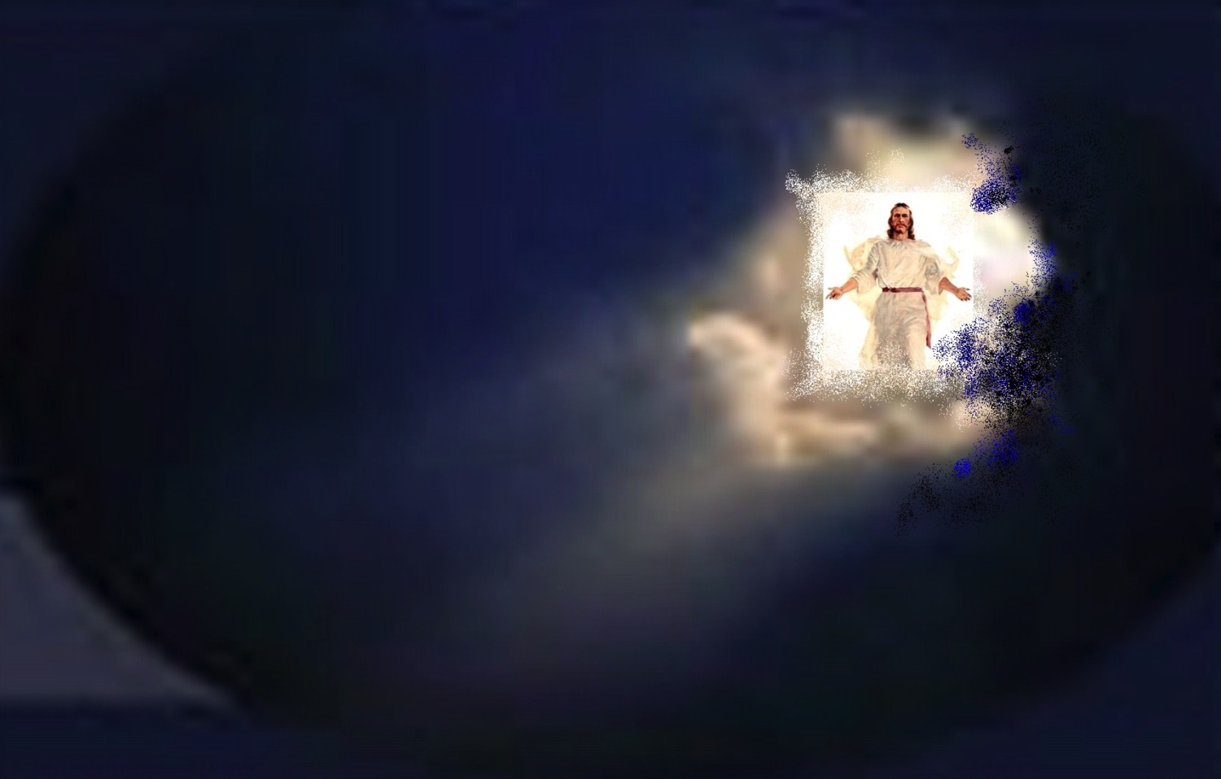
When will the Rapture occur?

Slide 57
Greek Prepositions
209 361
"from, out of, away from"
ek
peri
dia
"around"
"through"
eis
"into"
Notes:
"Frequently, but not always, ek means from within, while apo means from in a more general way (e.g., from the outside of, from the vicinity of)" (Eugene Van Ness Goetchius, The Language of the New Testament [New York: Charles Schribner's Sons, 1965], 151).

Slide 58
"Pre-Trib" Rapture
209 362
Second Coming
1. "I will keep you from (ek) the hour of testing that will come upon the whole world, to test those who dwell upon the earth"
(Rev. 3:10)
Rapture
Tribulation
Millennium
Church Age
Eternal Kingdom
7 years
1000 years
Judgment

Slide 59
"Pre-Trib" Rapture
209 362
Rapture
Second Coming
1. "I will keep you from (ek) the hour of testing that will come upon the whole world, to test those who dwell upon the earth"
(Rev. 3:10)
"from, out of, away from"
ek
Tribulation
Millennium
dia
Church Age
"through"
Eternal Kingdom
7 years
1000 years
eis
"into"
Judgment
Notes:
"Frequently, but not always, ek means from within, while apo means from in a more general way (e.g., from the outside of, from the vicinity of)" (Eugene Van Ness Goetchius, The Language of the New Testament [New York: Charles Schribner's Sons, 1965], 151).

Slide 60
"Pre-Trib" Rapture
209
Second Coming
2. "I will keep you from (ek) the hour of testing that will come upon the whole world, to test those who dwell upon the earth"
(Rev. 3:10)
Rapture
Tribulation
Millennium
Church Age
Eternal Kingdom
7 years
1000 years
Each time this "phrase occurs… the enemies of the church are always in mind” (Mounce, 120)
Judgment

Slide 61
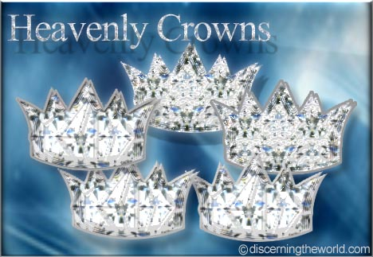
He promises rewards for perseverance (3:11b).
"I am coming soon. Hold on to what you have, so that no one will take away your crown" (NLT).
Notes:
Lack of endurance leads to loss of rewards—not loss of salvation.

Slide 62
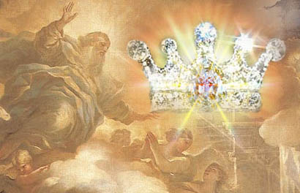
Rewards can be lost!
"Watch out that you do not lose what we have worked so hard to achieve. Be diligent so that you receive your full reward" (2 John 8 NLT)

Slide 63
The Overcomers (Rev. 2–3)
365
Pergamum
Thyatira
2:17
2:26
He who overcomes, I will make him a pillar in the temple of My God, and he will not go out from it anymore; and I will write on him the name of My God, and the name of the city of My God, the new Jerusalem, which comes down out of heaven from My God, and My new name (3:12)
Smyrna
Sardis
2:11
3:5
Ephesus
Philadelphia
2:7
3:12
Laodicea
Notes:
He promised them strength and security (3:12a).

Slide 64
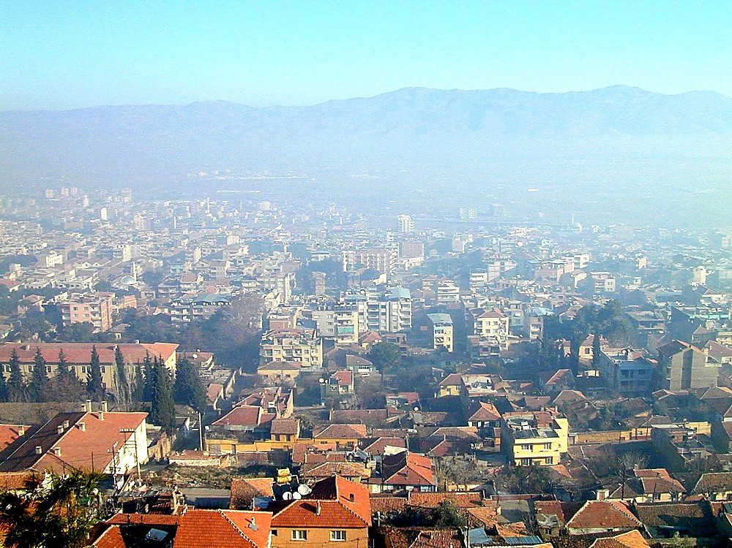
Philadelphia city from acropolis
Philadelphia pillars fell in many earthquakes
Notes:
One scholar notes, “The word picture of the pillar would have had special significance for the inhabitants of a city plagued with earthquakes. Pillars were support for buildings; this is a picture of God's solid nature and holy temple, compared with the fallen pillars of the pagan gods.
____________
The name mentioned in the verse would have had significance in light of the city's numerous name changes over the years. Naming is one way to claim possession; just as each emperor tried to claim dominion from the city by re-naming it, so God establishes His eternal dominion over the believers by giving them an eternal, unchanging name” (Bolen, slide 6 below).
___________________
Biblical Significance
Philadelphia is only mentioned in the book of Revelation. It was one of the two churches to whom the apostle John wrote during his exile on Patmos not receiving condemnation. Philadelphia was also the most recently founded city among the seven churches.
Revelation 3:9 (KJV) "Behold, I will make them of the synagogue of Satan, which say they are Jews, and are not, but do lie; behold, I will make them to come and worship before thy feet, and to know that I have loved thee." This is a reference to the opposition of believers in Philadelphia, the unbelieving Jewish population of the city. Many Jews lived in the city of Philadelphia.
Revelation 3:12 (KJV) "Him that overcometh will I make a pillar in the temple of my God, and he shall go no more out: and I will write upon him the name of my God, and the name of the city of my God, which is new Jerusalem, which cometh down out of heaven from my God: and I will write upon him my new name." The word picture of the pillar would have had special significance for the inhabitants of a city plagued with earthquakes. Pillars were support for buildings; this is a picture of God's solid nature and holy temple, compared with the fallen pillars of the pagan gods. The name mentioned in the verse would have had significance in light of the city's numerous name changes over the years. Naming is one way to claim possession; just as each emperor tried to claim dominion from the city by re-naming it, so God establishes His eternal dominion over the believers by giving them an eternal, unchanging name.

Slide 65
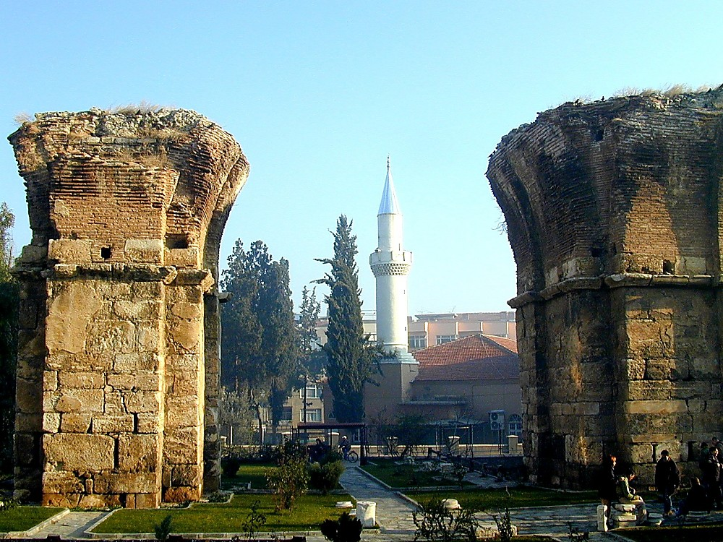
Philadelphia Church of St John columns
Philadelphia Church of St John columns
Notes:
The Church of St. John later had immense pillars in memory of this verse!

Slide 66
The Overcomers (Rev. 2–3)
365
Philadelphus
Neo Caesarea
Thyatira
Pergamum
2:17
2:26
Plabia
He who overcomes, I will make him a pillar in the temple of My God, and he will not go out from it anymore; and I will write on him the name of My God, and the name of the city of My God, the new Jerusalem, which comes down out of heaven from My God, and My new name (3:12)
Alesehir (today)
Smyrna
Sardis
2:11
3:5
Ephesus
Philadelphia
2:7
3:12
Notes:
"The name mentioned in the verse would have had significance in light of the city's numerous name changes over the years." I found at least four names for the city! Maybe there were more! [footnote below]
Also, our name identifies our family. “Because believers have identified with Christ by faith, He will identify Himself with them” (Walvoord, BKC).
_______________
Bolen notes, "Naming is one way to claim possession; just as each emperor tried to claim dominion from the city by re-naming it, so God establishes His eternal dominion over the believers by giving them an eternal, unchanging name" (Bolen, slide 6).
Our name identifies our family. "Because believers have identified with Christ by faith, He will identify Himself with them" (Walvoord, BKC).
Footnote: Bolen: "At the edge of the Katakekaumene (the "burned land") was a fertile volcanic plain suitable for agriculture, especially grapes; Philadelphia came to be known for its grape production. It was located in a region plagued by many earthquakes, which severely damaged the city in 17 and 23 A.D. Out of gratitude to Emperor Tiberius for his help in rebuilding it, the city took on the name Neo Caesarea. Emperor Rasmanianus changed this name to Plabia, after his wife, but this name also quickly went out of use" (slide 6). "The ancient city of Philadelphia lies under the modern city of Alesehir, Turkey" (slide 5)

Slide 67
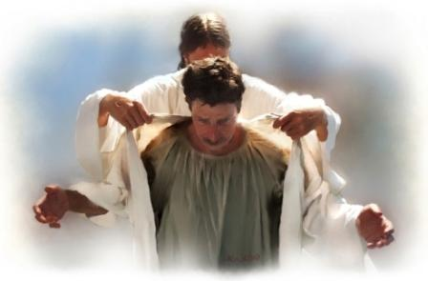
Jesus will reward our service too!

Slide 68
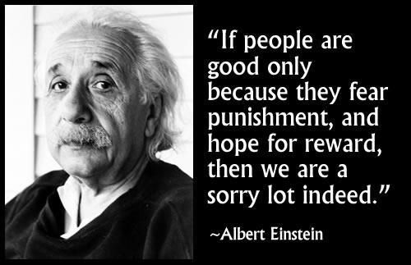
Albert Einstein
"If people are good only because they fear punishment, and hope for reward, then we are a sorry lot indeed."
"I have given you an open door that no one can shut" (3:8)
Notes:
Really?

Slide 69
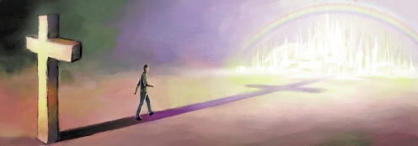
Rewards are not wrong
Notes:
It is not wrong to work for rewards. You do this at your job!

Slide 70
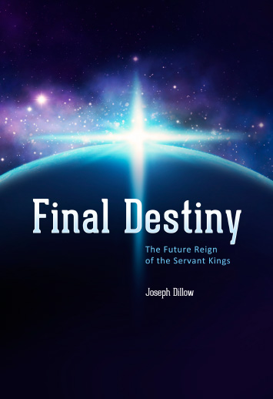
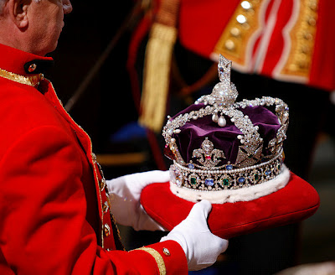
The Future Reign of the Servant Kings
Final Destiny
The Future Reign of the Servant Kings
Joseph Dillow
Notes:
In fact, Final Destiny is an entire book on the biblical view of rewards—subtitled The Future Reign of the Servant Kings. I recommend that you read it!

Slide 71
How does Jesus encourage us to reach out?
Notes:
So how does Jesus encourage us to reach out?

Slide 72
I. Christ opens doors for witness (3:7-8).

Slide 73
II. Christ promises rewards for service (3:9-13).

Slide 74
Main Idea
Jesus gives us both opportunities and rewards for witness
Notes:
Christ provides open doors for service and motivation to walk through those doors.

Slide 75
The Holy Huddle
THE HOLY HUDDLE
Worship • Unity • Focus
Notes:
So don’t stay in a holy huddle!

Slide 76
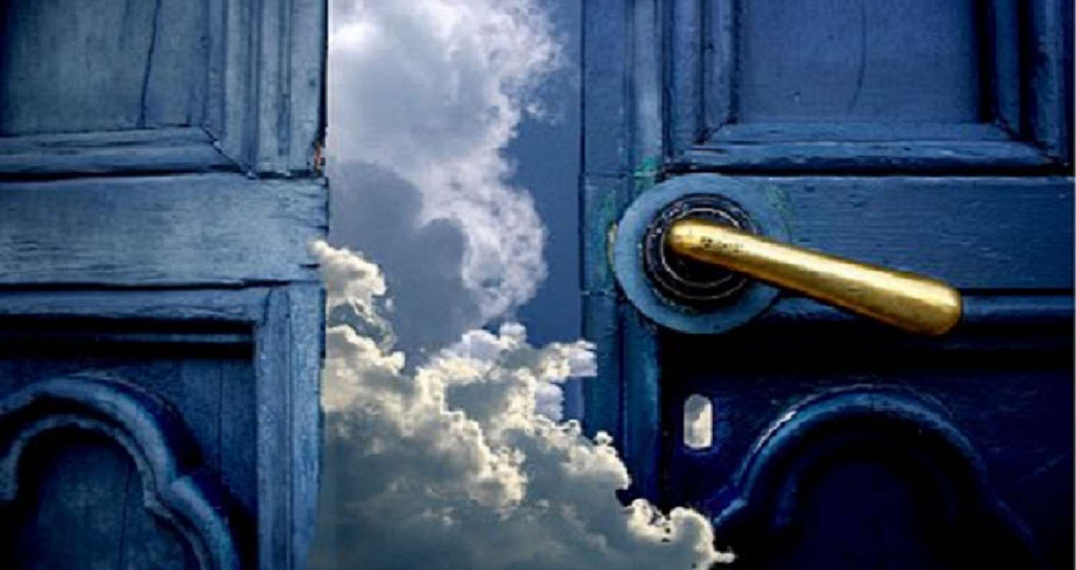
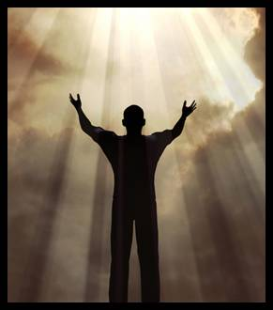
What open door has Christ given you for this year?
Write it down.
"I have given you an open door that no one can shut" (3:8)
Notes:
Did any of the mission trips seem like a fit for you?
How about local ministry to youth or prisoners?
God is bringing more new people here. Can you help gather them together?
Some love kids and babies, so there are open doors there too.
• Ask God which door you should step through and write it on your notes there in your seat. Give your open hands to His open doors!

Slide 77
Black

Slide 78
NT Preaching link at BibleStudyDownloads.org
Get this presentation and script for free!
Notes:
NT Preaching (np)

